Slide 1


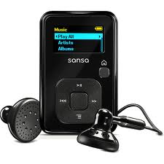
A CD of this message will be available (free of charge) immediately following today’s Bible study.
This message will be available for podcast at www.calvaryokc.com later this week

Slide 2
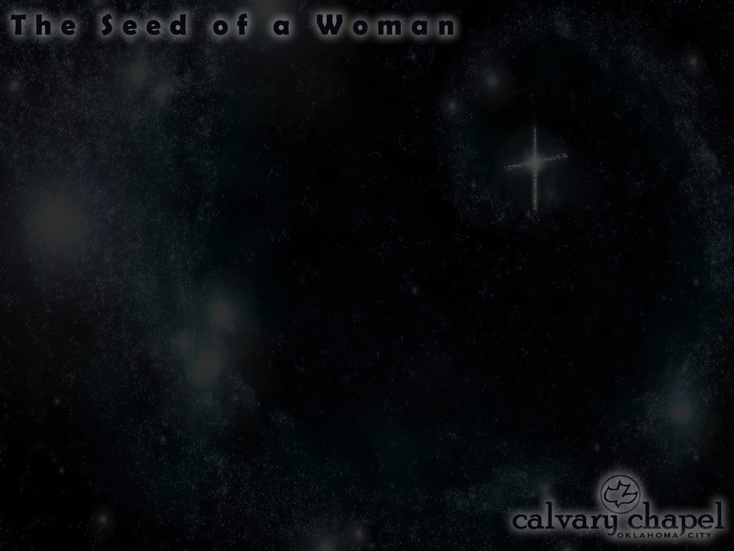
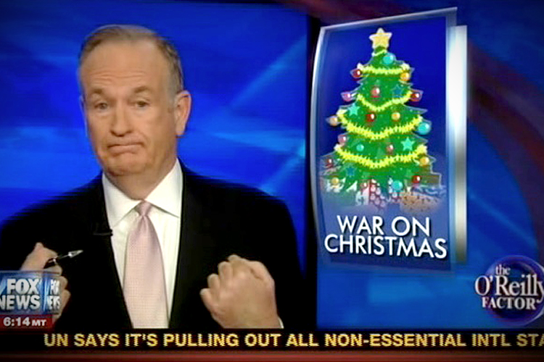


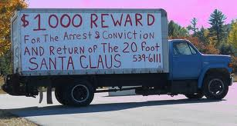

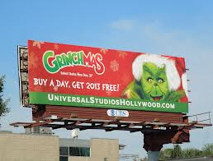

CHRISTMAS WARS

Slide 3
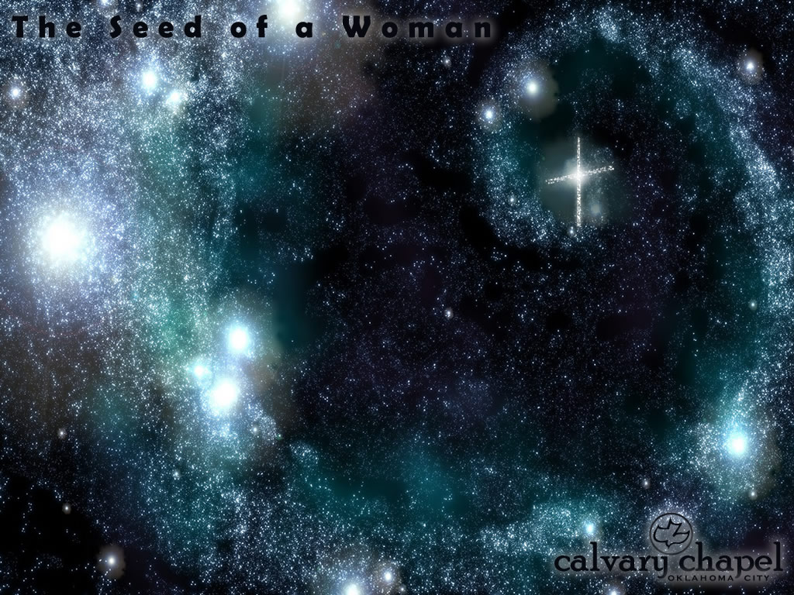

Slide 4
Gen. 3:15 ~ And I will put enmity
Between you and the woman,
And between your seed and her Seed;
He shall bruise your head,
And you shall bruise His heel.

Slide 5
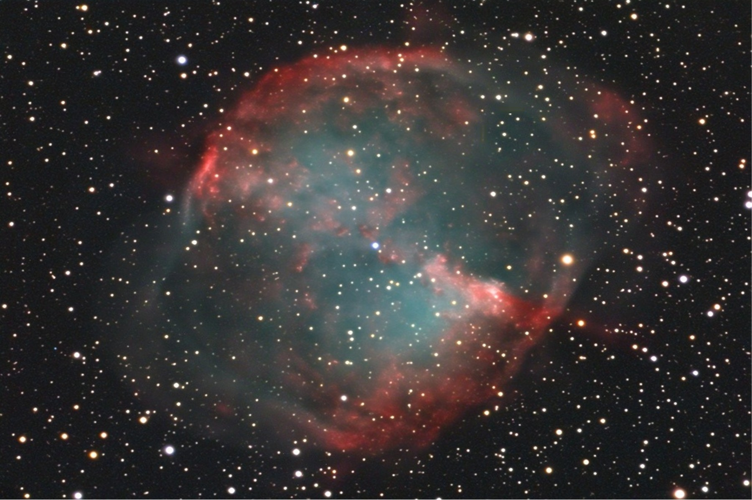

Slide 7
Through Abraham …
Genesis 12:2–3 ~ ² I will make you a great nation;
I will bless you
And make your name great;
And you shall be a blessing.
³ I will bless those who bless you,
And I will curse him who curses you;
And in you all the families of the earth shall be blessed.
… eliminates all other linages

Slide 8
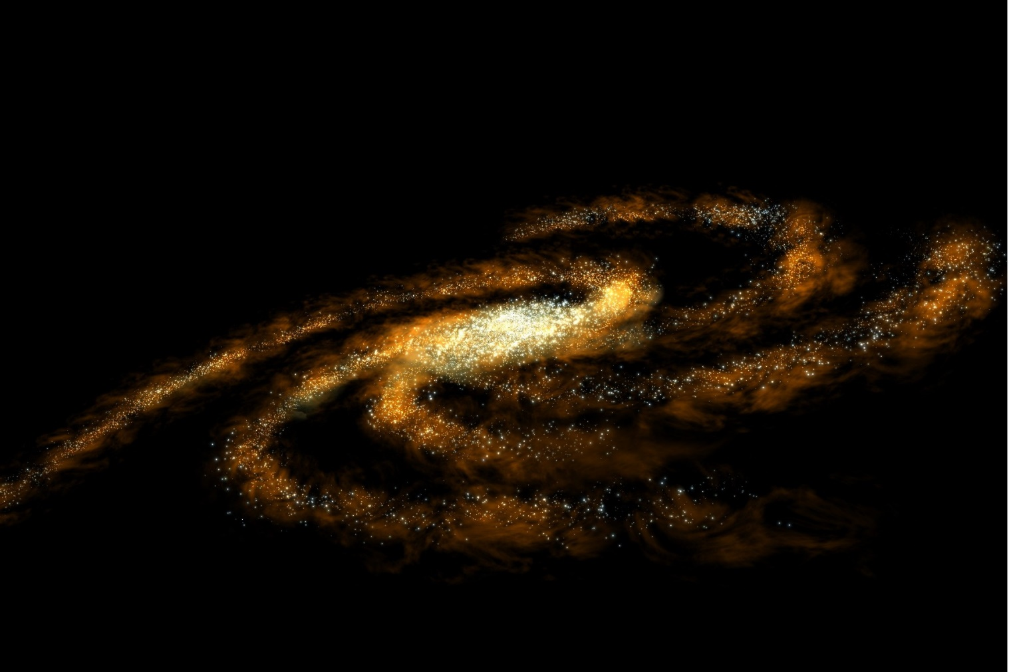
Through Abraham …
You are here
… eliminates all other linages

Slide 9
Through Isaac …
Gen. 17:19 ~ Then God said: "No, Sarah your wife shall bear you a son, and you shall call his name Isaac; I will establish My covenant with him for an everlasting covenant, and with his descendants after him."
… eliminates 1/2 all Abraham's
descendants

Slide 10
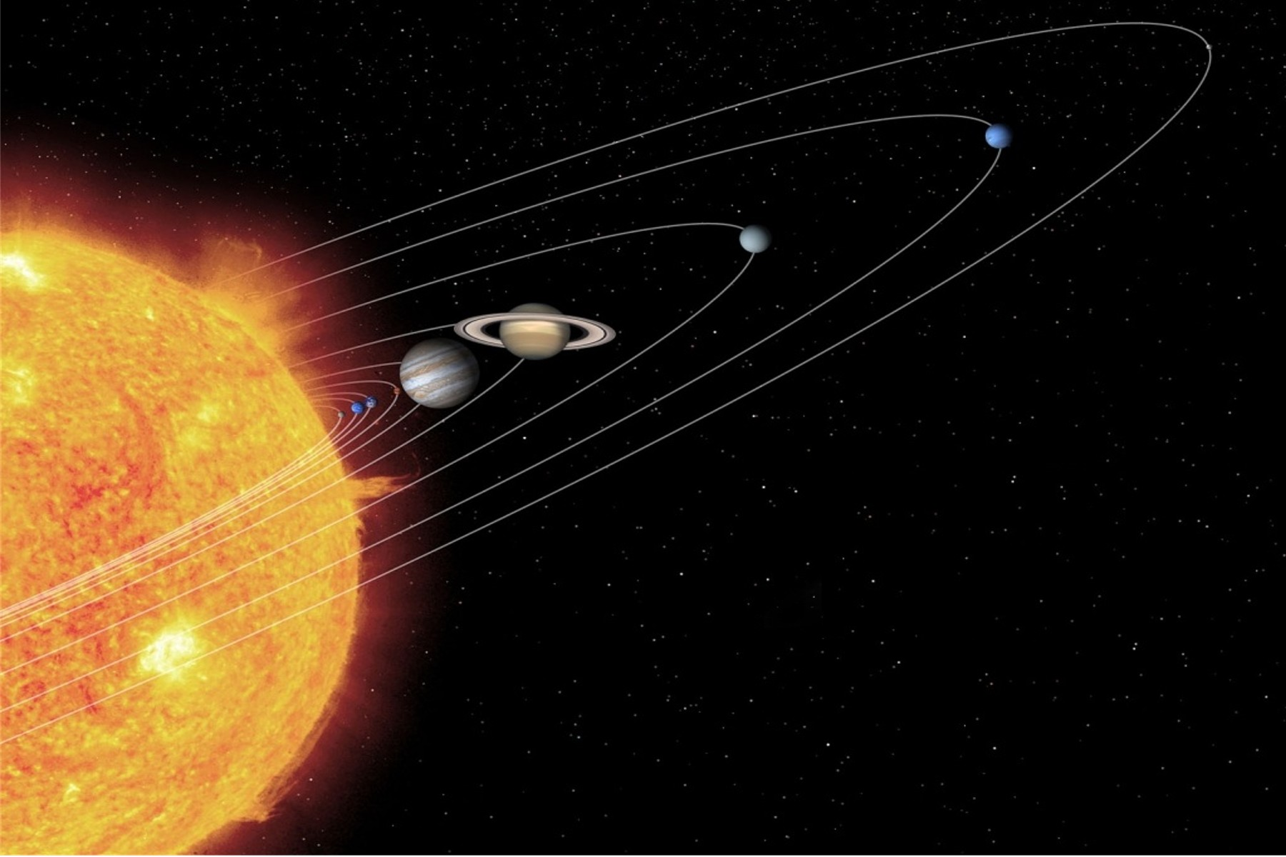
Through Isaac …
… eliminates 1/2 all Abraham's
descendants

Slide 11
Through Jacob …
Gen. 28: 13-15 ~ ¹³ And behold, the Lord stood above it and said: "I am the Lord God of Abraham your father and the God of Isaac; the land on which you lie I will give to you and your descendants. ¹⁴ Also your descendants shall be as the dust of the earth; you shall spread abroad to the west and the east,
to the north and the south; and in you and in your seed all the families of the earth shall be blessed. ¹⁵ Behold, I am with you and will keep you wherever you go, and will bring you back to this land; for I will not leave you until I have done what I have spoken to you."
… eliminates 1/2 all Isaac's
descendants

Slide 12
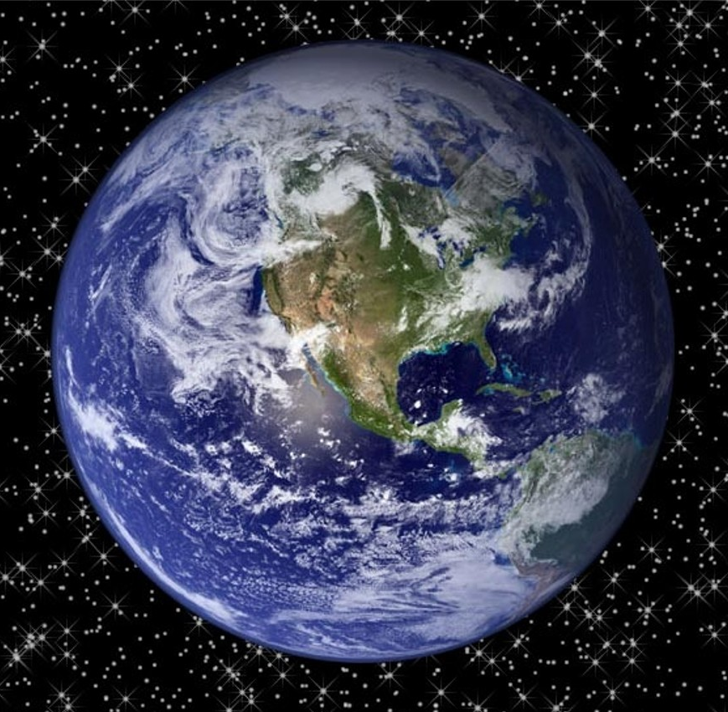
Through Jacob …
… eliminates 1/2 all Isaac's
descendants

Slide 13
Through Judah …
Gen. 49:10 ~ The scepter shall not depart from Judah,
Nor a lawgiver from between his feet,
Until Shiloh comes;
And to Him shall be the obedience of the people.
… eliminates 11/12 all Jacob's
descendants

Slide 14
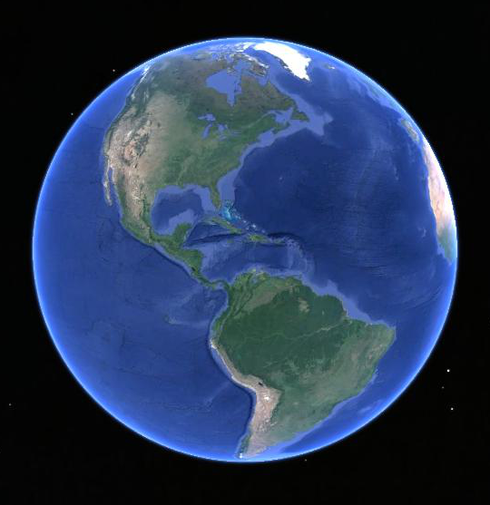
Through Judah …
… eliminates 11/12 all Jacob's
descendants

Slide 15
Through Jesse …
Is. 11:10 ~ And in that day there shall be a Root of Jesse,
Who shall stand as a banner to the people;
For the Gentiles shall seek Him,
And His resting place shall be glorious.
… eliminates all other clans in
Judah

Slide 16
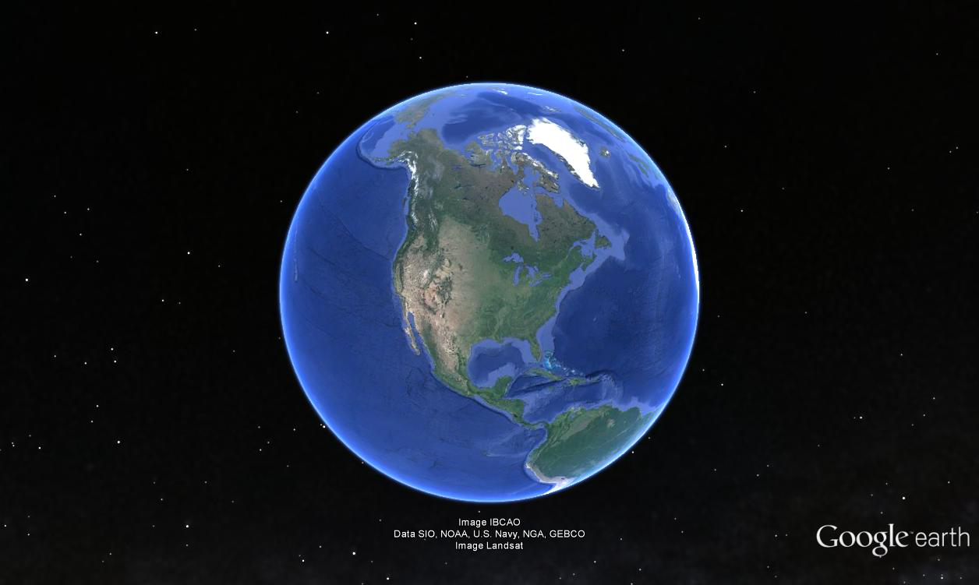
Through Jesse …
… eliminates all other clans in
Judah

Slide 17
Through David …
Jer. 23:5 ~ "Behold, the days are coming," says the Lord,
"That I will raise to David a Branch of righteousness;
A King shall reign and prosper,
And execute judgment and righteousness in the earth."
… eliminates 7/8 of Jesse's
descendants

Slide 18
Through David …
… eliminates 7/8 of Jesse's
descendants

Slide 19
Born in Bethlehem …
Mic. 5:2 ~ But you, Bethlehem Ephrathah,
Though you are little among the thousands of Judah,
Yet out of you shall come forth to Me
The One to be Ruler in Israel,
Whose goings forth are from of old,
From everlasting.
… eliminates all other possible
birth places

Slide 20
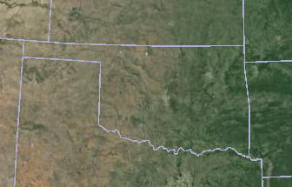
Born in Bethlehem …
… eliminates all other possible
birth places

Slide 21
Betrayed for 30 pieces of silver…
Zech. 11:12 ~ Then I said to them, "If it is agreeable to you, give me my wages; and if not, refrain." So they weighed out for my wages thirty pieces of silver.
… eliminates all other possible
betrayal amounts

Slide 22
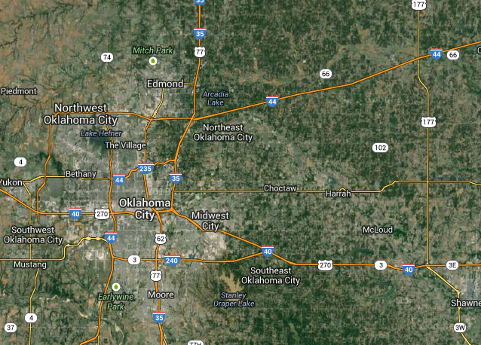
Betrayed for 30 pieces of silver …
… eliminates all other possible
betrayal amounts

Slide 23
Money used for a potters' field …
Zech. 11:13 ~ And the Lord said to me, "Throw it to the potter"—that princely price they set on me. So I took the thirty pieces of silver and threw them into the house of the Lord for the potter.
… eliminates all other
expenditures of ransom

Slide 24
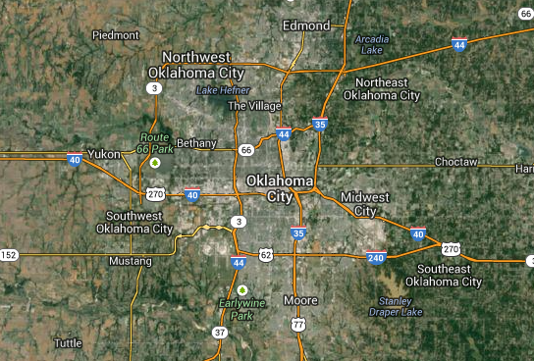
Money used for a potters' field …
… eliminates all other
expenditures of ransom

Slide 25
Crucified on a cross …
Psalm 22
… eliminates all other
methods of execution

Slide 26
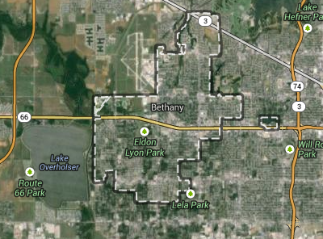
Crucified on a cross …
… eliminates all other
methods of execution

Slide 27
Buried in a rich man's grave …
Is. 53:9 ~ And they made His grave with the wicked—
But with the rich at His death,
Because He had done no violence,
Nor was any deceit in His mouth.
… eliminates all other
forms of burial

Slide 28
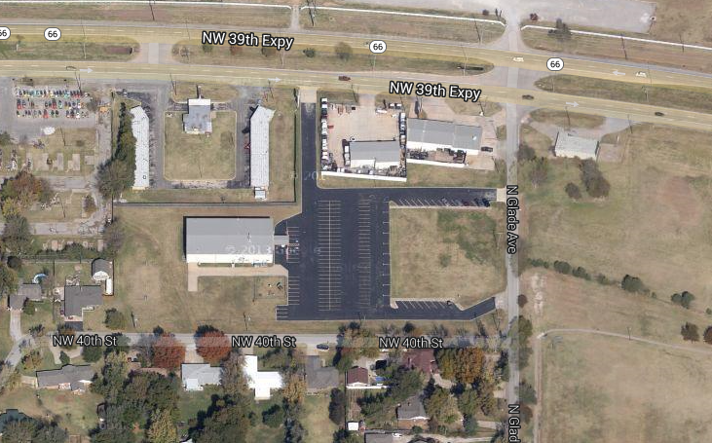
Buried in a rich man's grave …
7510 NW 39th Expressway, Bethany, OK 73008
… eliminates all other
forms of burial

Slide 30
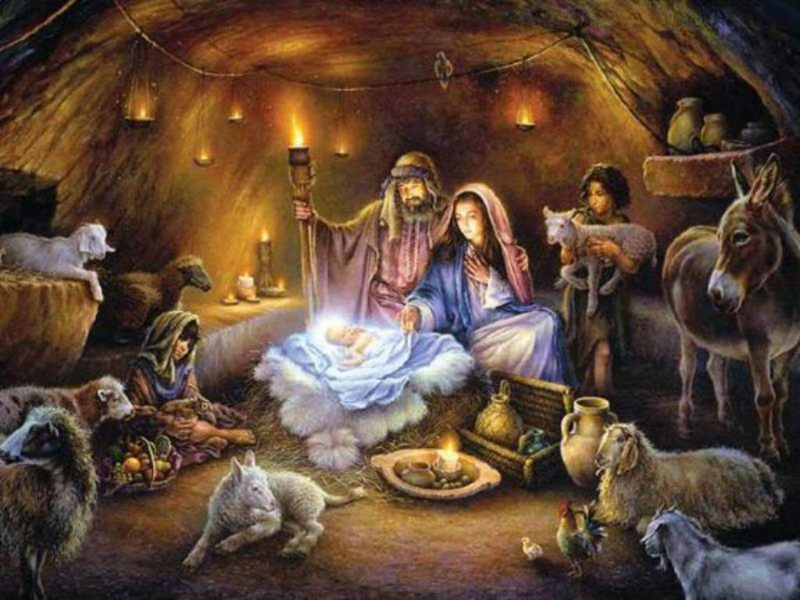
You can reject who He is …
… but you cannot deny who He is

Slide 32
Corrie ten Boom ~ "If Jesus were born one thousand times in Bethlehem and not in me, then I would still be lost."

